Slide 1
Mini Project - 1
S3 Buckets

Slide 2
Introduction:
Amazon Simple Storage Service (Amazon S3) or Amazon S3 is an object type, high-speed or with minimal latency, low-cost and scalable storage service provided by AWS. S3 also allows you to store as many objects as you’d like with an individual object size limit of five terabytes. It provides 99.999999999 (11 ‘9’s) percent durability and 99.99 percent availability of the objects which reside in it. In this article, you will create your first bucket in Amazon S3.

Slide 3
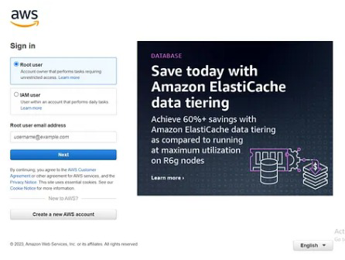
Step 1: Log on to your AWS Console. If you don’t have an account, you can create it absolutely free as Amazon provides a 1-year free tier to its new users.

Slide 4
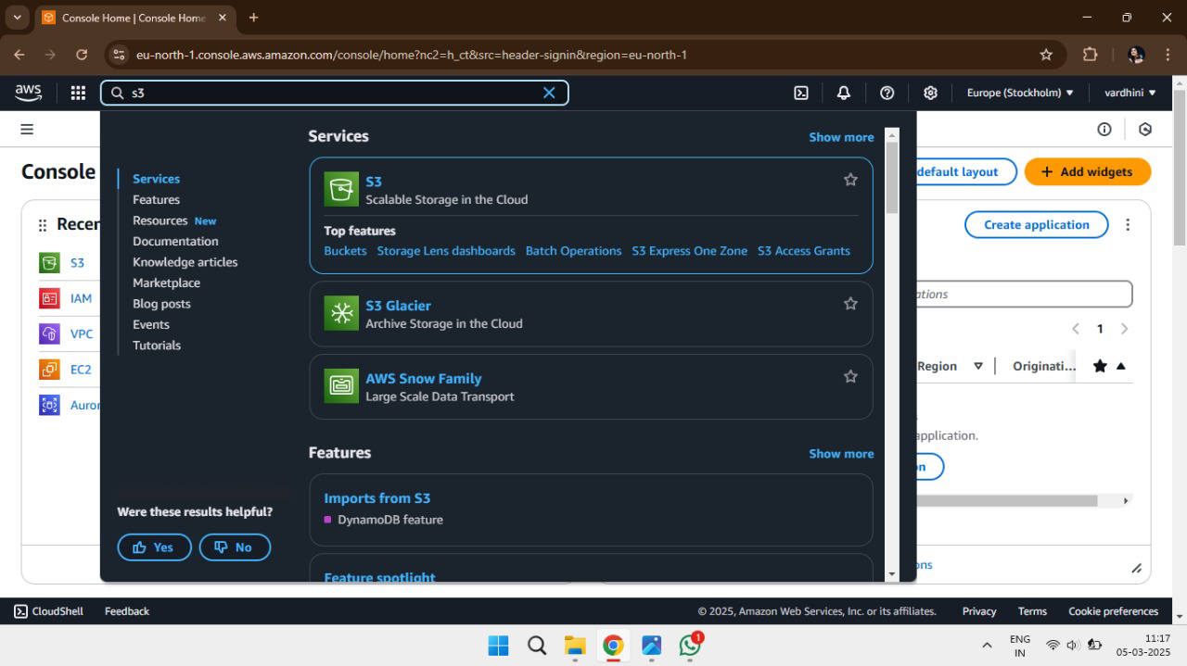
Step 2: In the search bar located at the top of your AWS Management Console, type “Amazon S3”. You will see something like this:

Slide 5
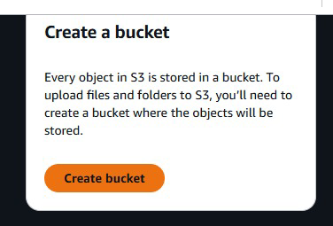
Step 3: Click on “S3 – Scalable Storage in the Cloud” and proceed further. Step 4: Click on “Create Bucket”. A new pane will open up, where you have to enter the details and configure your bucket.

Slide 6
Step 5: Enter the name of your bucket (We are giving geeks for geeks-bucket in our case). The following are some rules for naming a bucket in Amazon S3:
A bucket name should be unique across all Amazon S3 buckets.
Bucket names must be between 3 and 63 characters long.
Bucket names can consist only of lowercase letters, numbers, dots (.), and hyphens (-).
You cannot write a bucket name as an IP Address like 192.168.0.1.
Bucket names must begin and end with a letter or number.

Slide 7
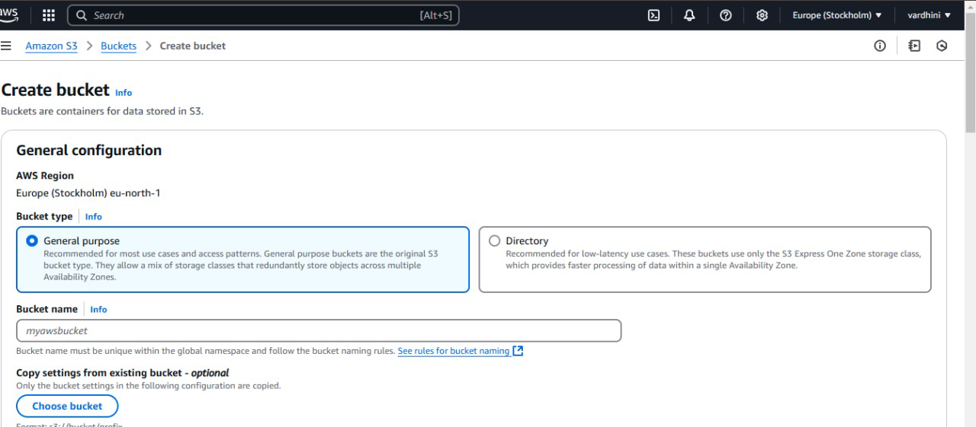

Slide 8
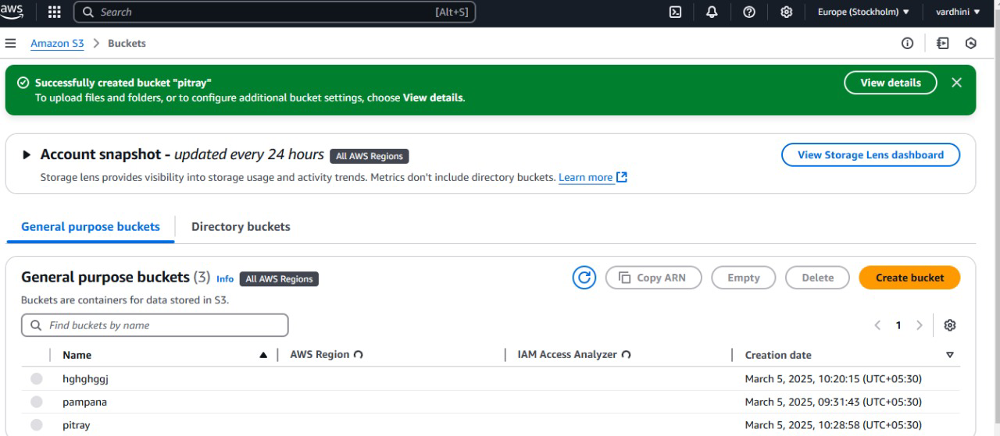
Step 6: Click on Create Bucket. If the bucket is created successfully, you will see a message like this on the top of the page:

Slide 9
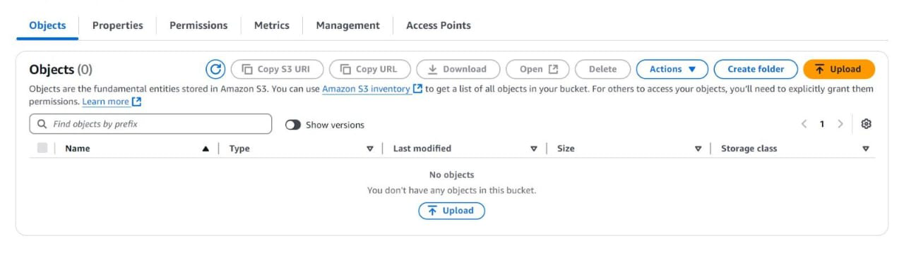
Step 7: After successfully create s3 bucket you need to upload to upload file in folder

Slide 10
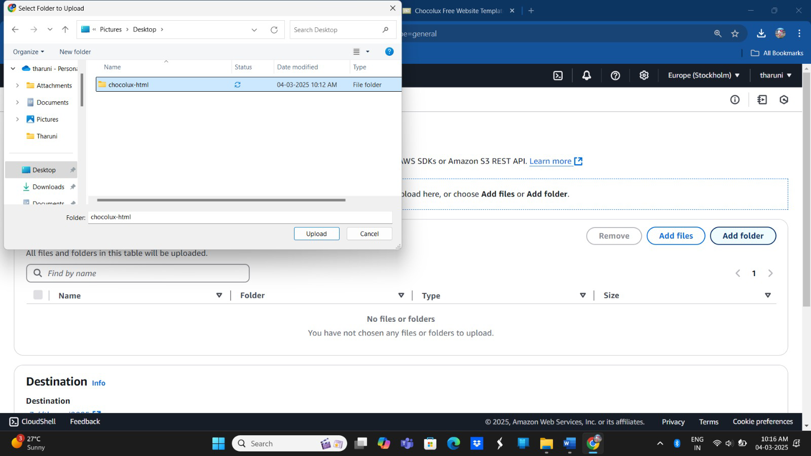
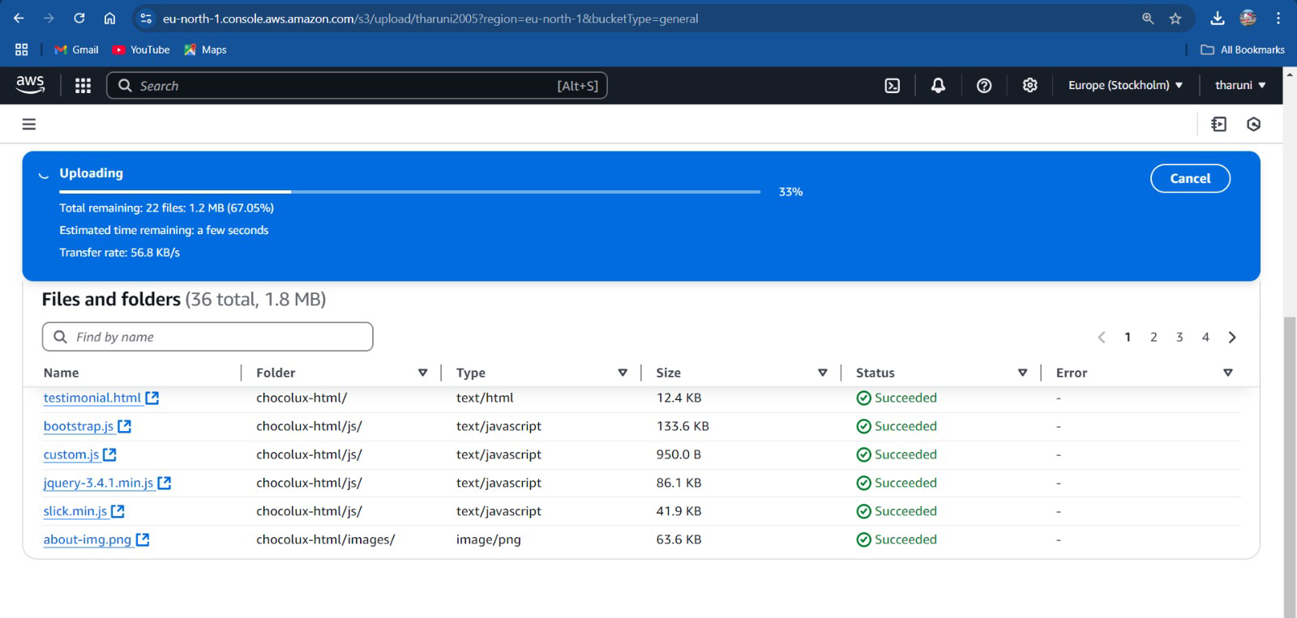

Slide 11
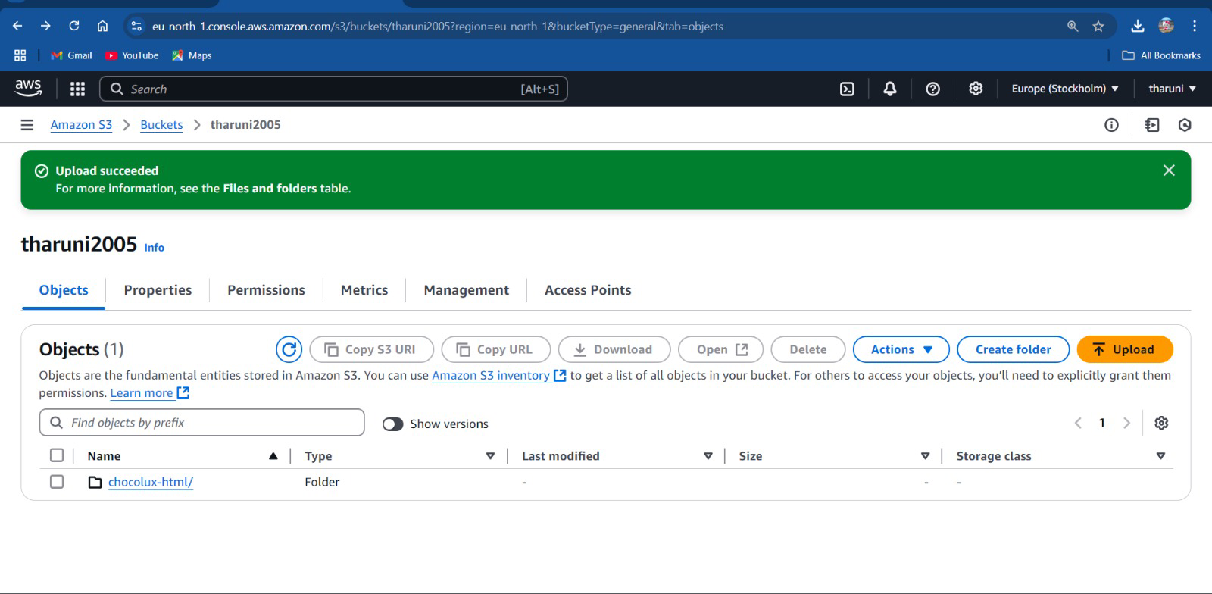
Step 9: The folder will successfully upload.

Slide 12
Create an AWS Account
MINI PROJECT - 2

Slide 13
Introduction:
Amazon Web Services (AWS) is a leading cloud service provider that allows users to access computing power, storage and other resources on demand. To use AWS services, the first step is to create an AWS account. This document provides an account, including security verification, email confirmation, personal details submission, and billing information.

Slide 14
Follow these instructions carefully to complete the process and gain access to AWS’s Free Tier services.
Step-1: Sign Up for AWS
1.Open a web browser and go to the AWS Signup Page: the AWS Signup Page:
URL:https://signin.aws.amazon.com/signup.
2.On the sign, up for AWS page:
Enter your Root user email address.
Provide your AWS account name.
3.Click the Verify email address button to proceed.

Slide 15
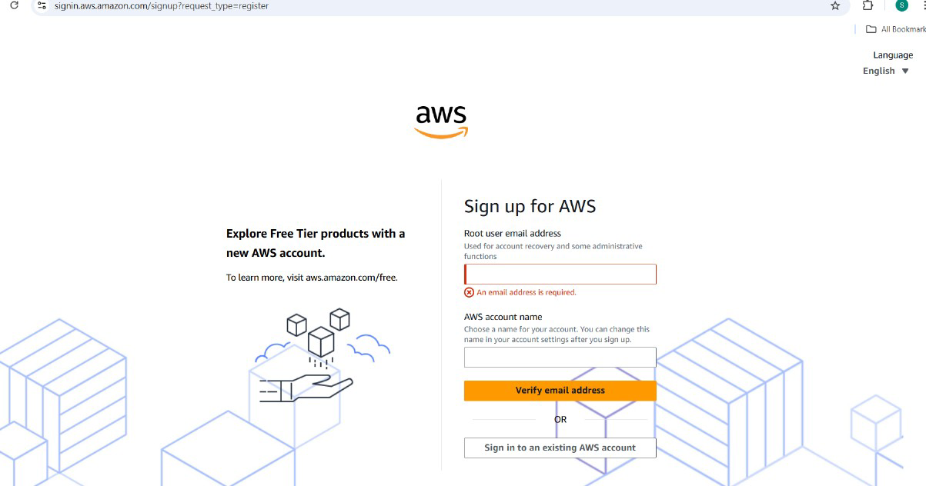

Slide 16
Step-2: Security Verification
1.After clicking Verify email address, a Security Verification screen will appear.
2.You will see a CAPTCHA with a mix of letters and numbers (E.G:7Zgp63).
Type the characters exactly as shown into the input box.
Click the Submit button.
3.If the CAPTCHA is not clear, you can:
Use the refresh button to generate a new code.

Slide 17
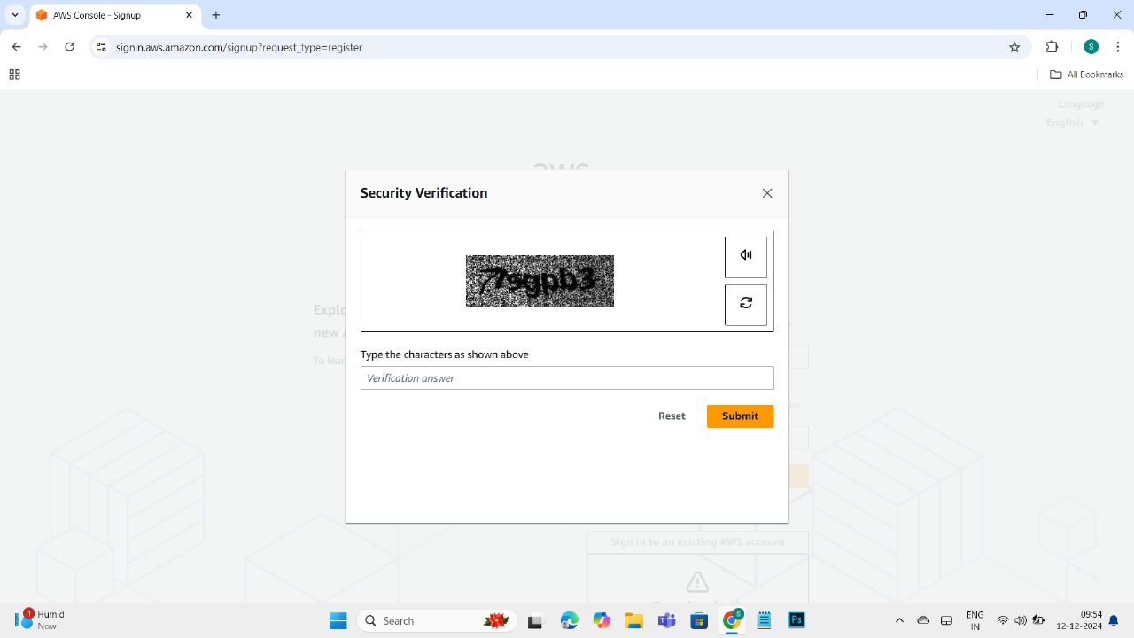
Click the audio button to hear the characters.

Slide 18
Step-3: Email Verification
1. AWS will send a verification code to the email address you provided.
2. Open your email inbox and locate the email from AWS with the verification code.
3. Enter the verification code in the provided input box on the AWS page.
4. Click the Verify button to confirm and proceed.

Slide 19
Step 4: Create Your Password
1. After a successful email verification, the system will prompt you to create a password for your AWS account.
2. Enter a strong password that meets AWS security requirements.
3. Confirm the password by entering it again in the provided input box.
4. Click Continue to move to the next step.

Slide 20
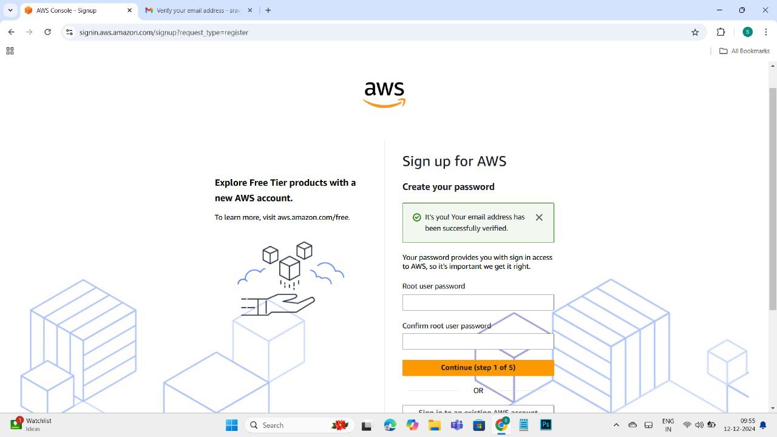

Slide 21
Step 5: Enter Personal Details
1. On the Personal Details page, enter the following
information:
•Full Name
•Phone Number
• Country/Region
•Address
• City/State
• Postal Code
2. Ensure all information is correct and complete.
3. Click Continue to proceed to billing details.

Slide 22
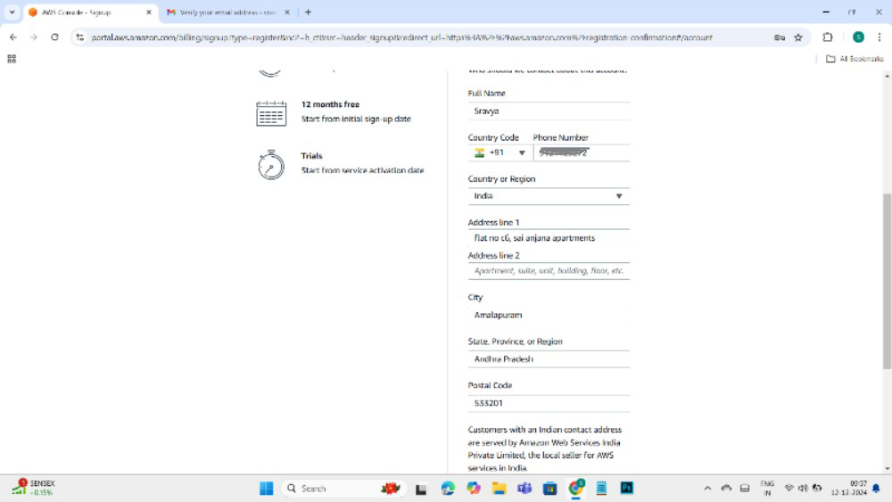

Slide 23
Step 6: Enter Billing Information
1. AWS requires valid Credit Card or Debit Card details to verify your identity and enable services. I
2. Enter the following information:
• Card Number
• Name on Card
• Expiration Date
• CVV (Security Code)
3. Double-check the entered details for accuracy.
4. Click Submit to complete the billing verification.

Slide 25
Conclusion:
After successfully completing all the steps:
1. AWS will verify your information.
2. You will receive a confirmation email stating that your account has been created.
3. You can now log in to your AWS Management Console and start exploring Free Tier services.

